Slide 1
Image Classification
Is it a cat or a dog?

Slide 2
What is an Image?
An image is basically a matrix of pixels.
These pixels are represented by integers , for a black and white picture each pixel will have only one integer whereas for a colored picture they are represented by a set of three integers that represent the color as a combination of RGB (Red Green and Blue)

Slide 3
How can u classify these images into classes?
We can use the classification algorithms like SVC,Random forest,decision trees,KNN and so on.
But these algorithms are not very efficient in extracting the features (like ears ,nose in the image) and also take up a lot of preprocessing and running time for large datasets.
So we use Deep learning to improve the accuracy of our classification.

Slide 4
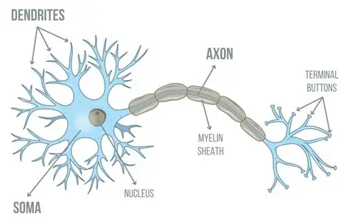
What is Deep Learning?
Deep Learning is a methodology in which the machine learns the given data multiple times by validating how much it has learnt simultaneously.
Here architecture is similar to our brains:
We have neurons which connect to other neurons and communicate by sending signals,

Slide 5
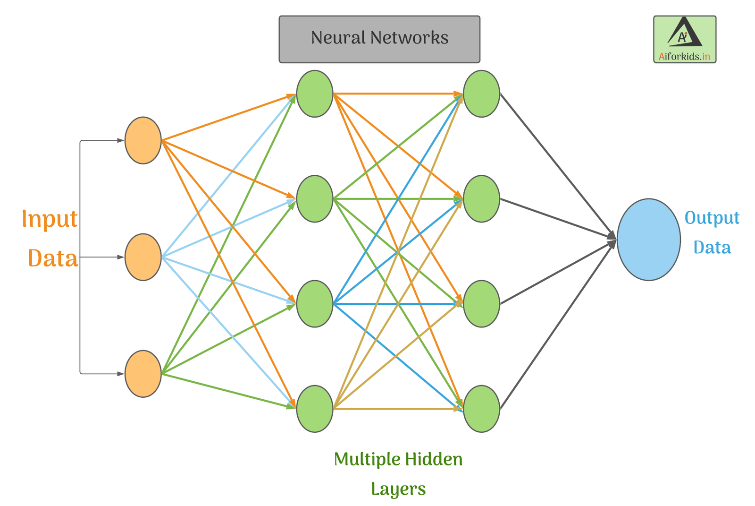
How is Deep Learning similar to our brains?
In deep learning we have neurons / nodes analogous to the neurons in our brain, each node is connected to several other nodes just like in the brain and they also communicated with each other by passing information.
These several nodes are arranged in layers , namely three:
One Input Layer
One or more Hidden Layers
One Output Layer
Such a network of neurons/ nodes is called a neural network.
Each Link in the neural network has a weight associated with it
A network with only one hidden layer is called a shallow neural network whereas the ones with more than one are called deep neural networks.

Slide 6
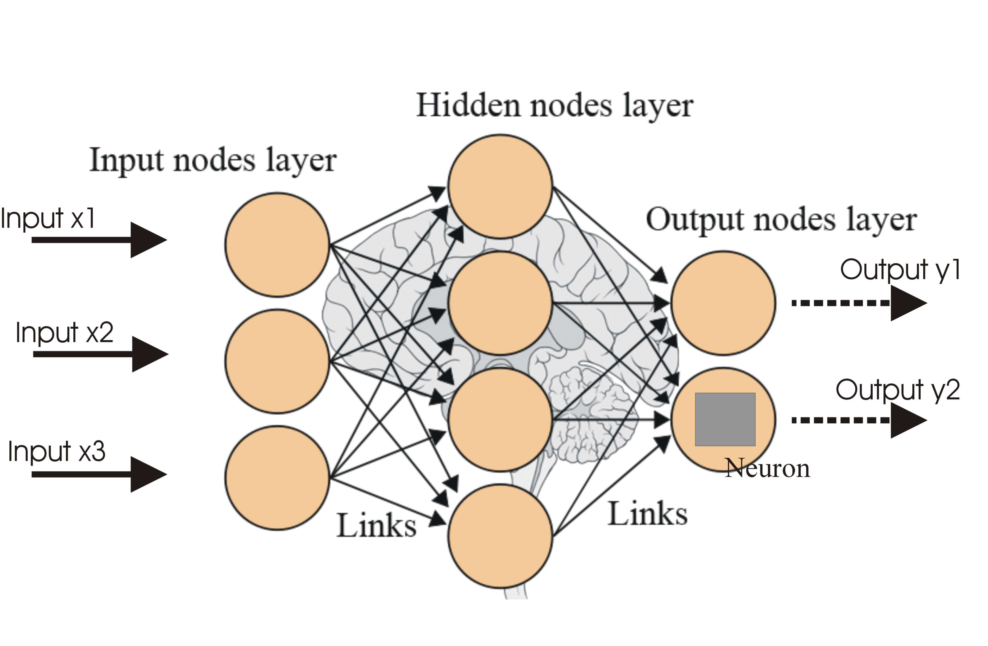
How does a neural network work? Input layer:
Starting with the Input layer:
This layer contains n number of nodes where n is the number of features / columns in our dataset each node representing one feature. This layer then sends information about the feature it represents to the next layer , the hidden layer.

Slide 7
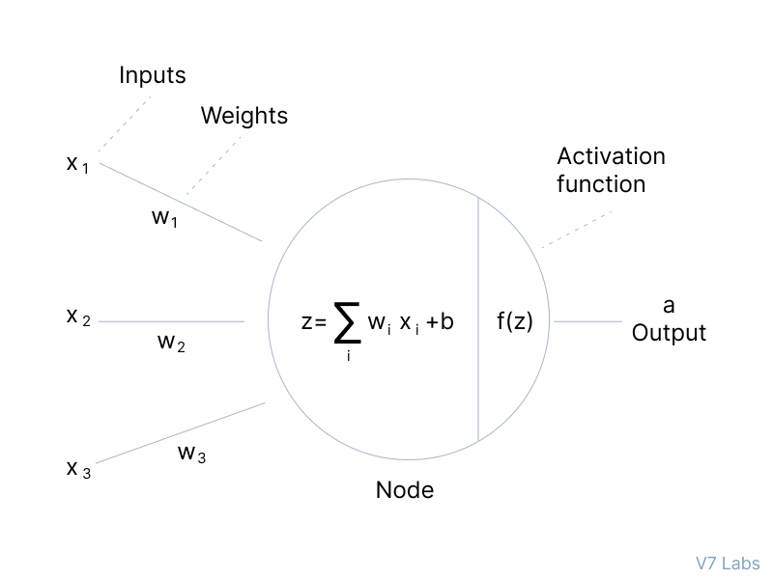
How does a neural network work? Hidden Layer:
Each Hidden layer is again made of a number of neurons, each neuron performs an activation function on the information received from the input layer.
These activation functions are mainly:
Rectified Linear unit function
Sigmoid function
Step function
tanh(x) or hyperbolic tangent function
These activation functions are used to introduce Non-linearity in the system.

Slide 8
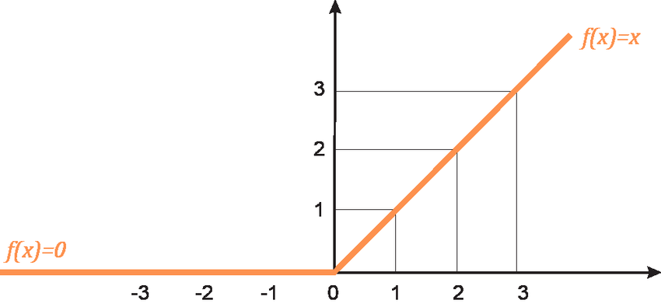
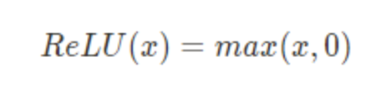
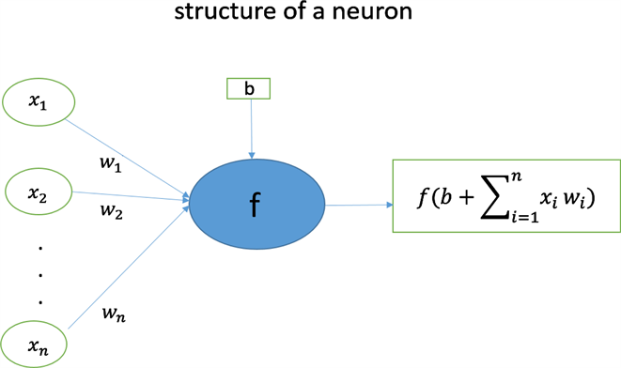
Rectified Linear Unit function
Rectified linear unit also known as the ReLU function can be defined as follows:
Where x is the weighted sum .i.e
x = w₁·a₁ + w₂·a₂ + ... + wₙ·aₙ + b
Where wi is the weight of the link I connected to node n
ai is the input to the node n by link l and
b is the bias

Slide 9
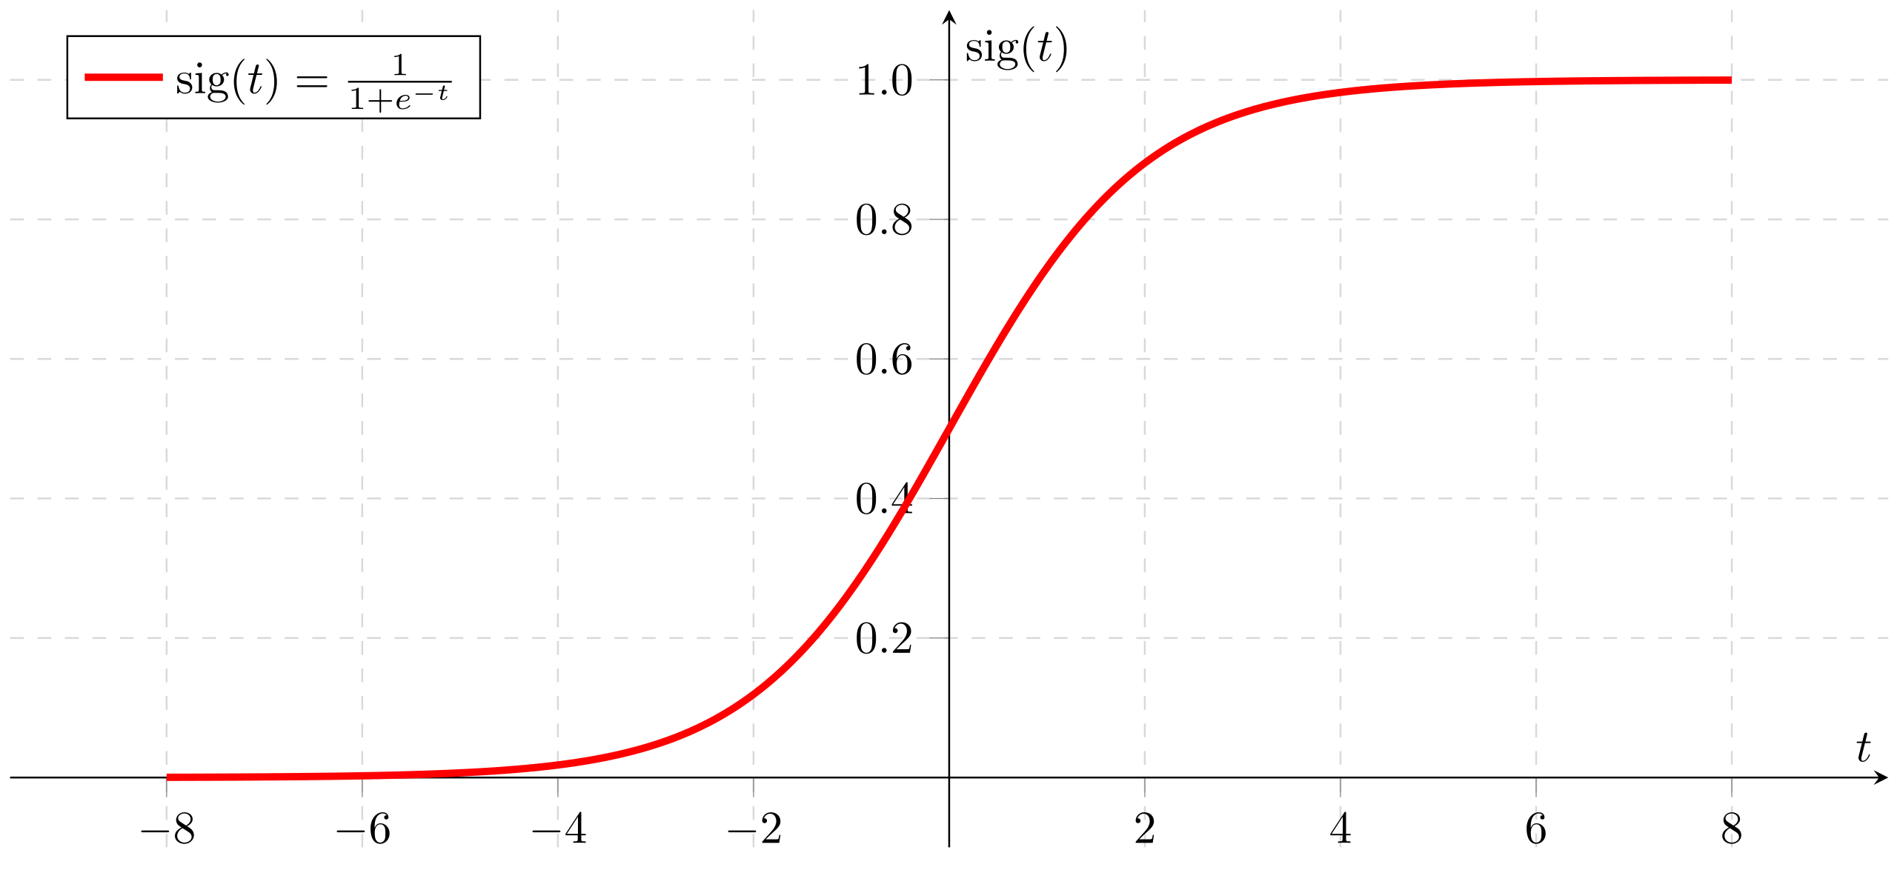
Sigmoid Function
The sigmoid function can be defined as follows:
Here again , t is the weighted sum

Slide 10
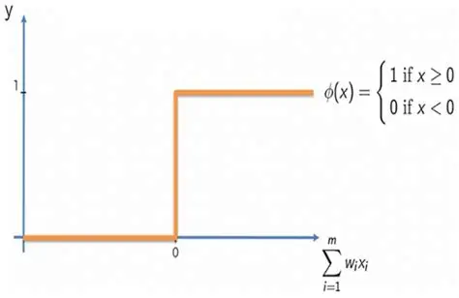
Step function
The step function can be defined as follows:
Here again the x ( input to the function) is the weighted sum for that neuron

Slide 11

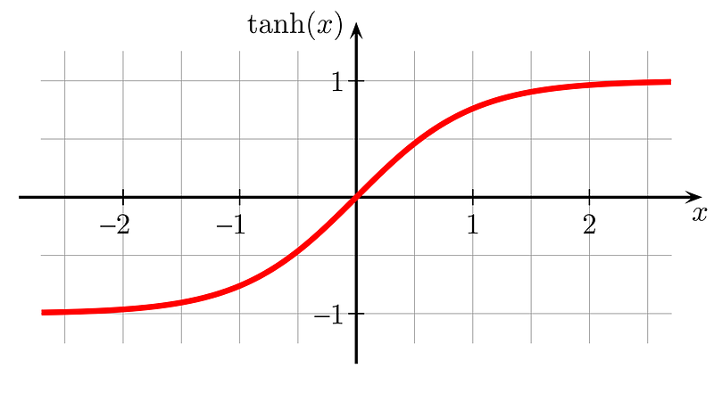
Hyperbolic Tangent Function : tanh(x)
The tanh(x) can be defined as follows:
Where , z is the weighted sum

Slide 12
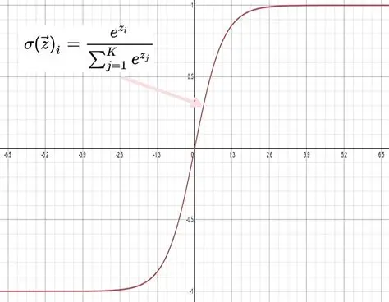
How does a neural network work? Output layer:
The output Layer performs the classification .i.e it classifies the inputs into classes
To perform this it uses two functions namely ,
Sigmoid function : used for binary classification
Softmax function: used for classification into multiple classes
Softmax function :

Slide 13

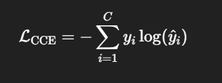
Loss calculation (cross_entropy)
After the classification by the output layer , the loss is calculated as:
For binary classification:
For mutli-class classification:
Where yi is the actual output and yi_hat is the predicted value

Slide 14

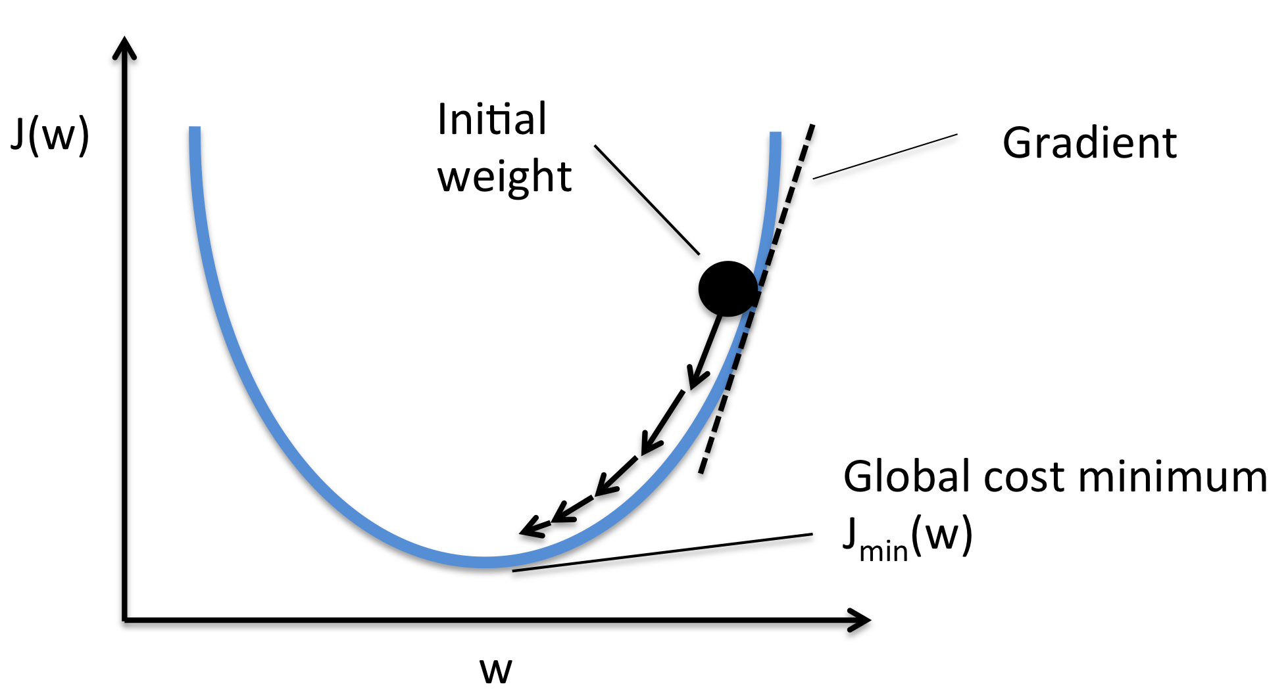
How is Loss minimized?
We need to minimize the loss to ensure that the predicted results are as close as possible to the actual results
We can minimize the loss by using the concept of gradient descent.
For any curve ,the tangent to the curve at a particular point is given by its derivative at that point
The slope of the tangent tells us the direction in which the y increases wrt x ,
If slope> 0 then y increases as x increases
If slope< 0 then y increases as x decreases
Similarly in a loss vs weights curve the slope at each point denoting weight will tell us the direction in which the loss will increase and since our objective is to minimize this loss we update the weights in the opposite direction of the slope.
This is done after each iteration /epoch

Slide 15
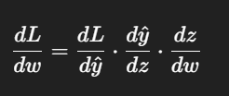
Backpropogation
In a neural network with several hidden layers we need to use chain rule in order to be able to find the derivative of loss wrt to its weight
Where L is the loss, y_cap is the predicted output and Z is the weighted sum.
Since it appears like the derivative comes from the next hidden layer backwards the name backpropogation is used

Slide 16
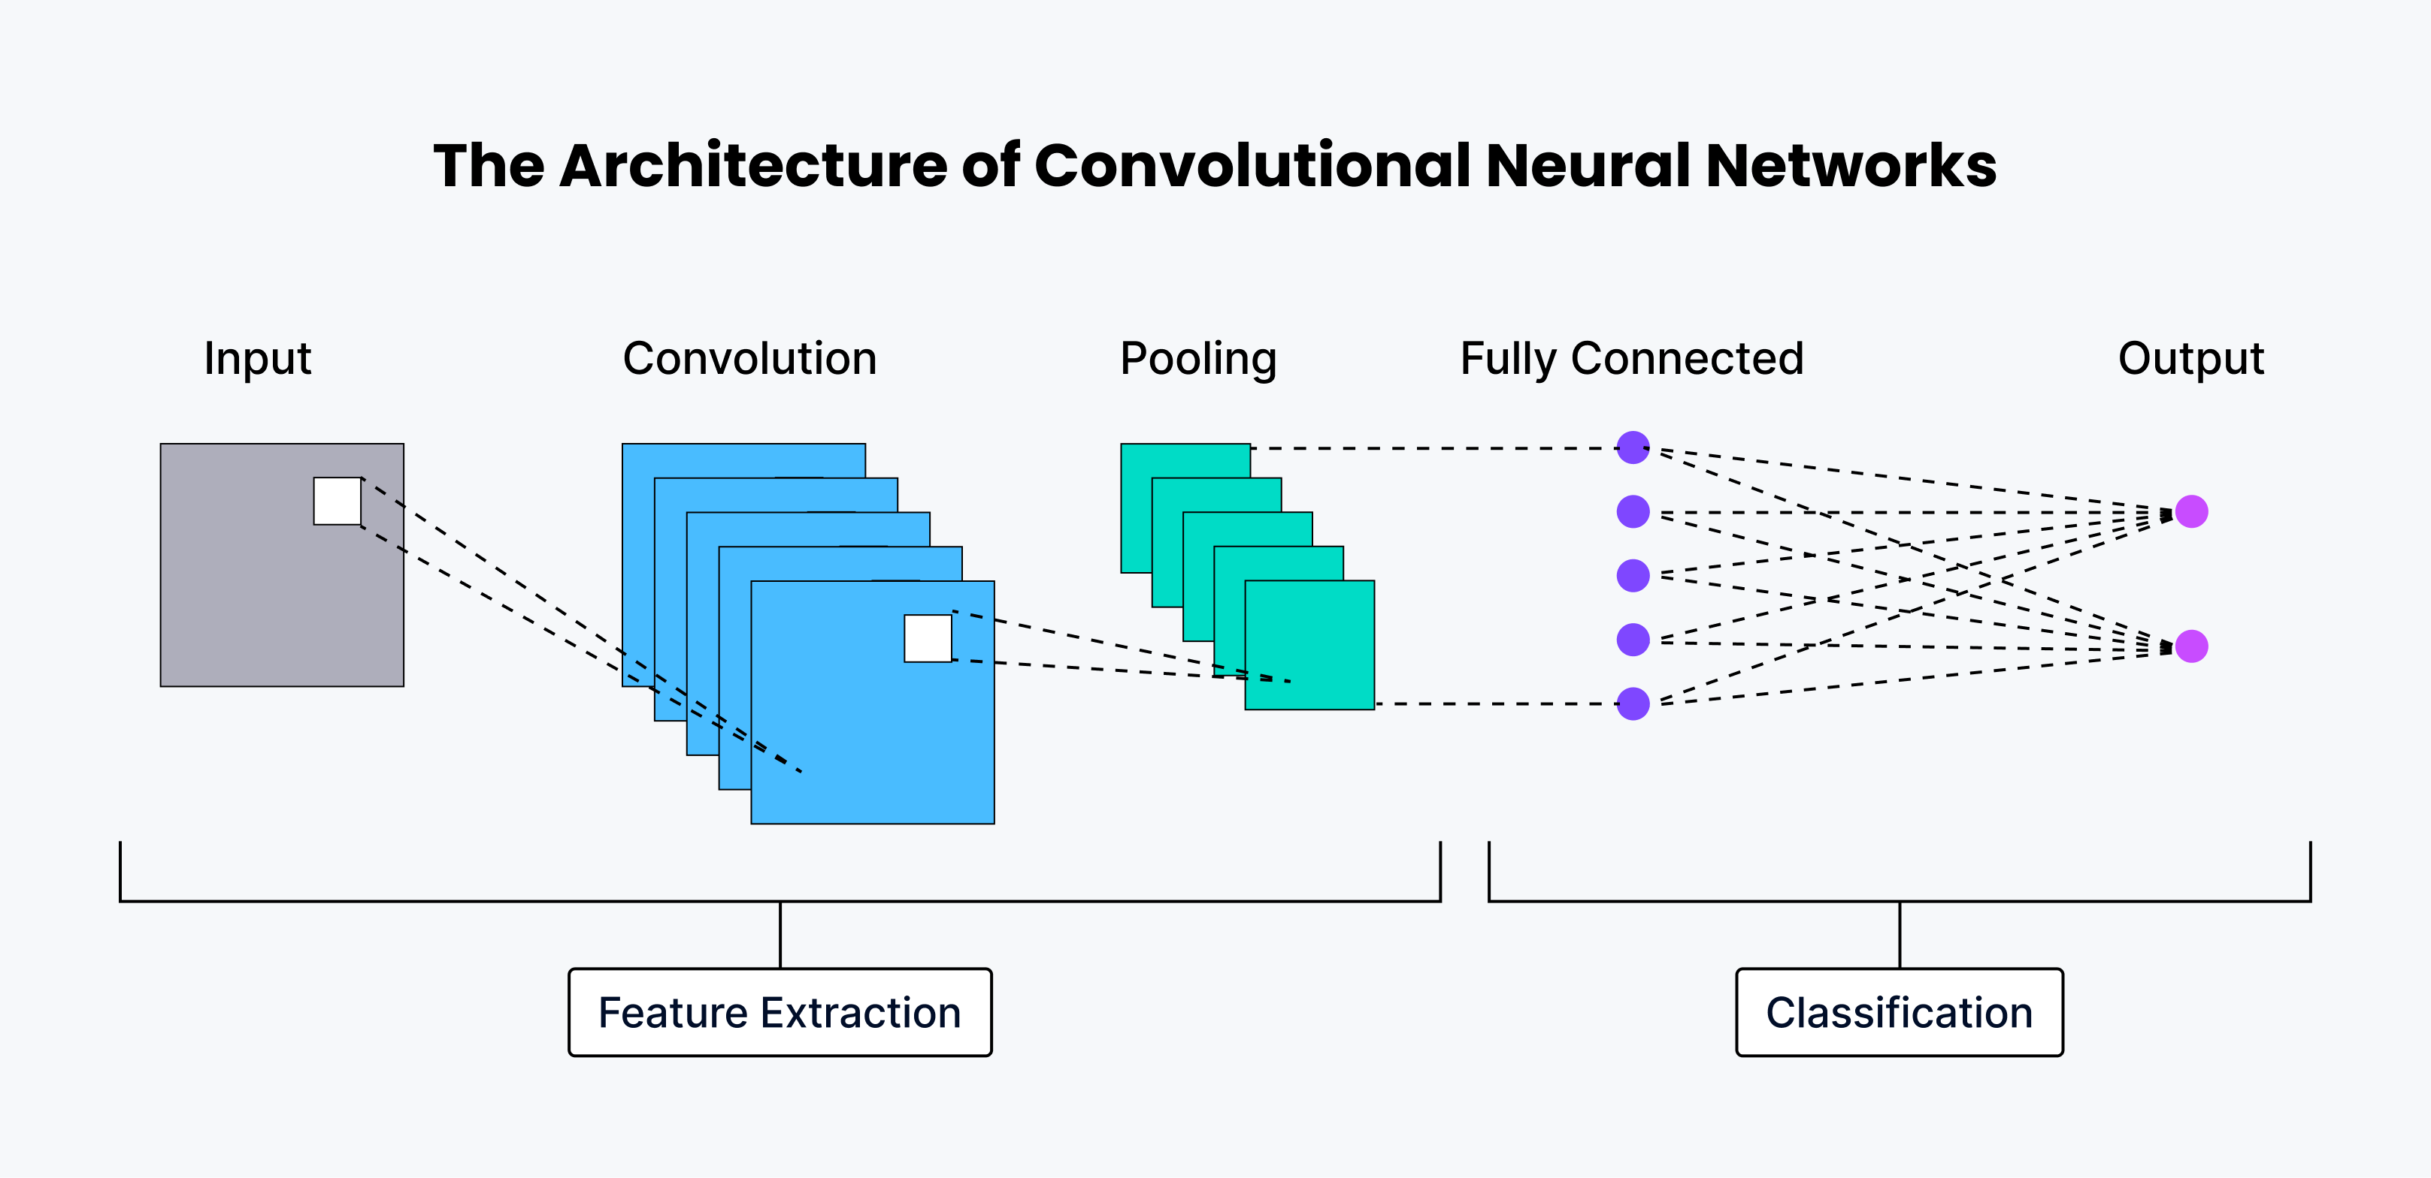
Convolutional Neural Networks
Convolutional Neural Networks (CNNs) are a type of neural network architecture specifically designed to work with image data. While they share a similar structure to Artificial Neural Networks (ANNs), CNNs include additional layers — like convolution and pooling — that allow them to handle large images efficiently.
In an ANN, each input pixel is connected to every neuron in the next layer, which leads to a very large number of weights, especially for high-resolution images. This not only makes computation expensive but also makes learning unstable — changing one weight can drastically affect the output.
Moreover, ANNs are not translation-invariant — they struggle to recognize an object like a dog if it appears in a different location or orientation than it did during training. CNNs overcome this by using convolutional filters that scan across the image and extract local features regardless of position. Pooling layers help in reducing dimensionality and improving spatial invariance.
Thus, CNNs allow us to build image classifiers that are more efficient, more robust, and better at generalizing to new image variations.

Slide 17
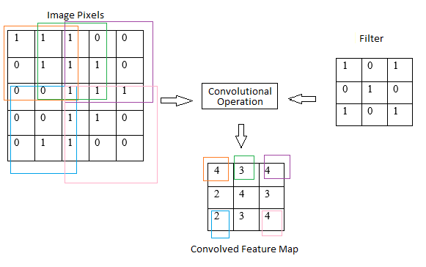
What is convolution?
You slide a small matrix (the filter or kernel) over the input image (or feature map) and perform an element-wise multiplication + summation at each location. This gives you a single number per patch, resulting in a feature map.
Filters = Weights:The filter values are learnable parameters (weights), just like in an artificial neural network (ANN). These weights are shared across the image.
In ANN: you have weighted sums ,
In CNN: each filter slide is doing a similar operation on a spatial patch

Slide 18
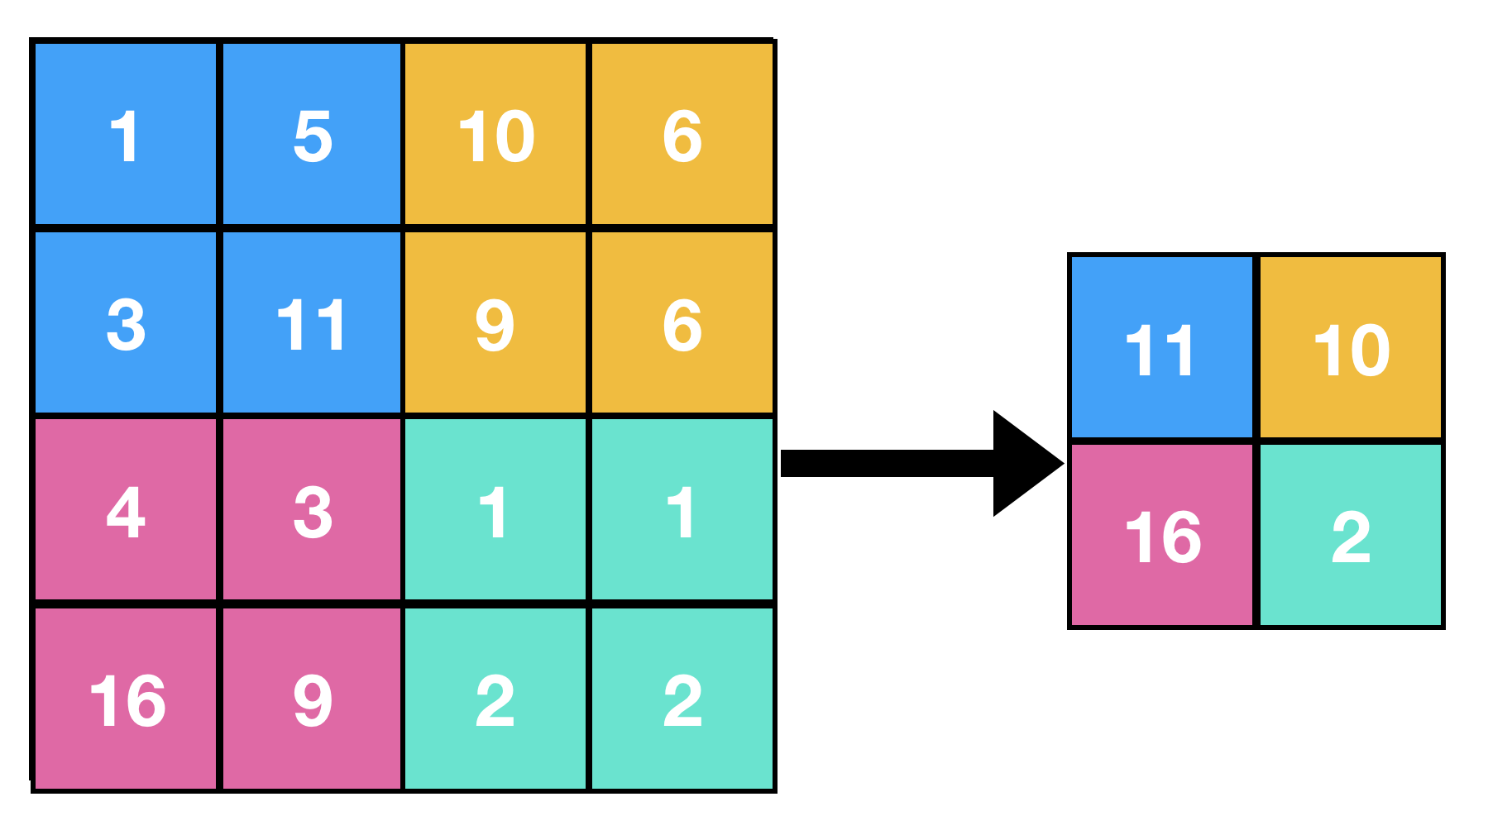
What is pooling?
After a convolution operation, the resulting feature map (i.e., filtered image) still has high dimensions. Pooling reduces this while retaining essential features.
Types of Pooling:
Max Pooling: Takes the maximum value from each patch of the feature map.
Keeps the most prominent feature in each patch.
Average Pooling: Takes the average of the values in each patch.
Gives a smoothed, less sharp output.

Slide 19
The architecture of a CNN
The general structure of a CNN usually involves the input layer which is the pixels of the image
This is then passed through the hidden layer.
In each of the hidden layer, the convolution operation is performed first then the activation function is applied on the weighted sum after which it is downsized in the pooling operation
The output of each hidden layer is then passed to the next hidden layer and so on.
Finally the second last hidden layer flattens the 2D image to 1D and passes it to a fully connected layer which performs the classification operation.
The outputs of the last fully connected layer is passed to the output layer which then classifies them to their classes by using a softmax or sigmoid activation function

Slide 20
Our Dataset
The dataset contains a training set and a test set.
The training set consists of 8000 real life images in total of cats and dogs.
The test set contains 2000 real life images of cats and dogs.
The training set will be used for training our neural network .
The test set will be used for validating the trained model.

Slide 21
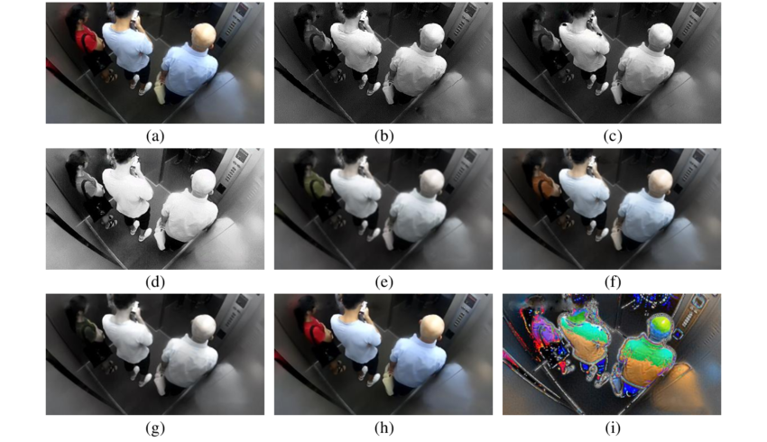
Preprocessing and augmenting the images
Although we can directly use these images as inputs without processing them , processing them will give us better results as this will help the model learn and generalize better.
It also helps increase the overall efficiency of the program.
The images can be preprocessed by rescaling them , flipping them, resizing them, rotating them randomly , highlighting the edges, sharpening the image ,blurring them etc.
All of this helps in extracting features and the model in generalizing better and not memorizing the given images.
Thus increasing the accuracy of the model.

Slide 22
How do we preprocess it?
We preprocess the image by rescaling it to 1./255, horizontally flipping them, zooming in/out by 0.2 and using shear_range=0.2 ,this means the image can be disorted randomly within a range of ±0.2 radians (about ±11.5 degrees).
We resize all the images in the training and the test set to be of the size 100,100,3 as these are colored images.
We set the batch size to 32 and the class mode to binary as well be classifying the images into two classes dogs and cats.
Thus each epoch will have 250 training sets as 8000/32=250. That is the model learns from only 32 images in the training set out of 8000 during each epoch.

Slide 23
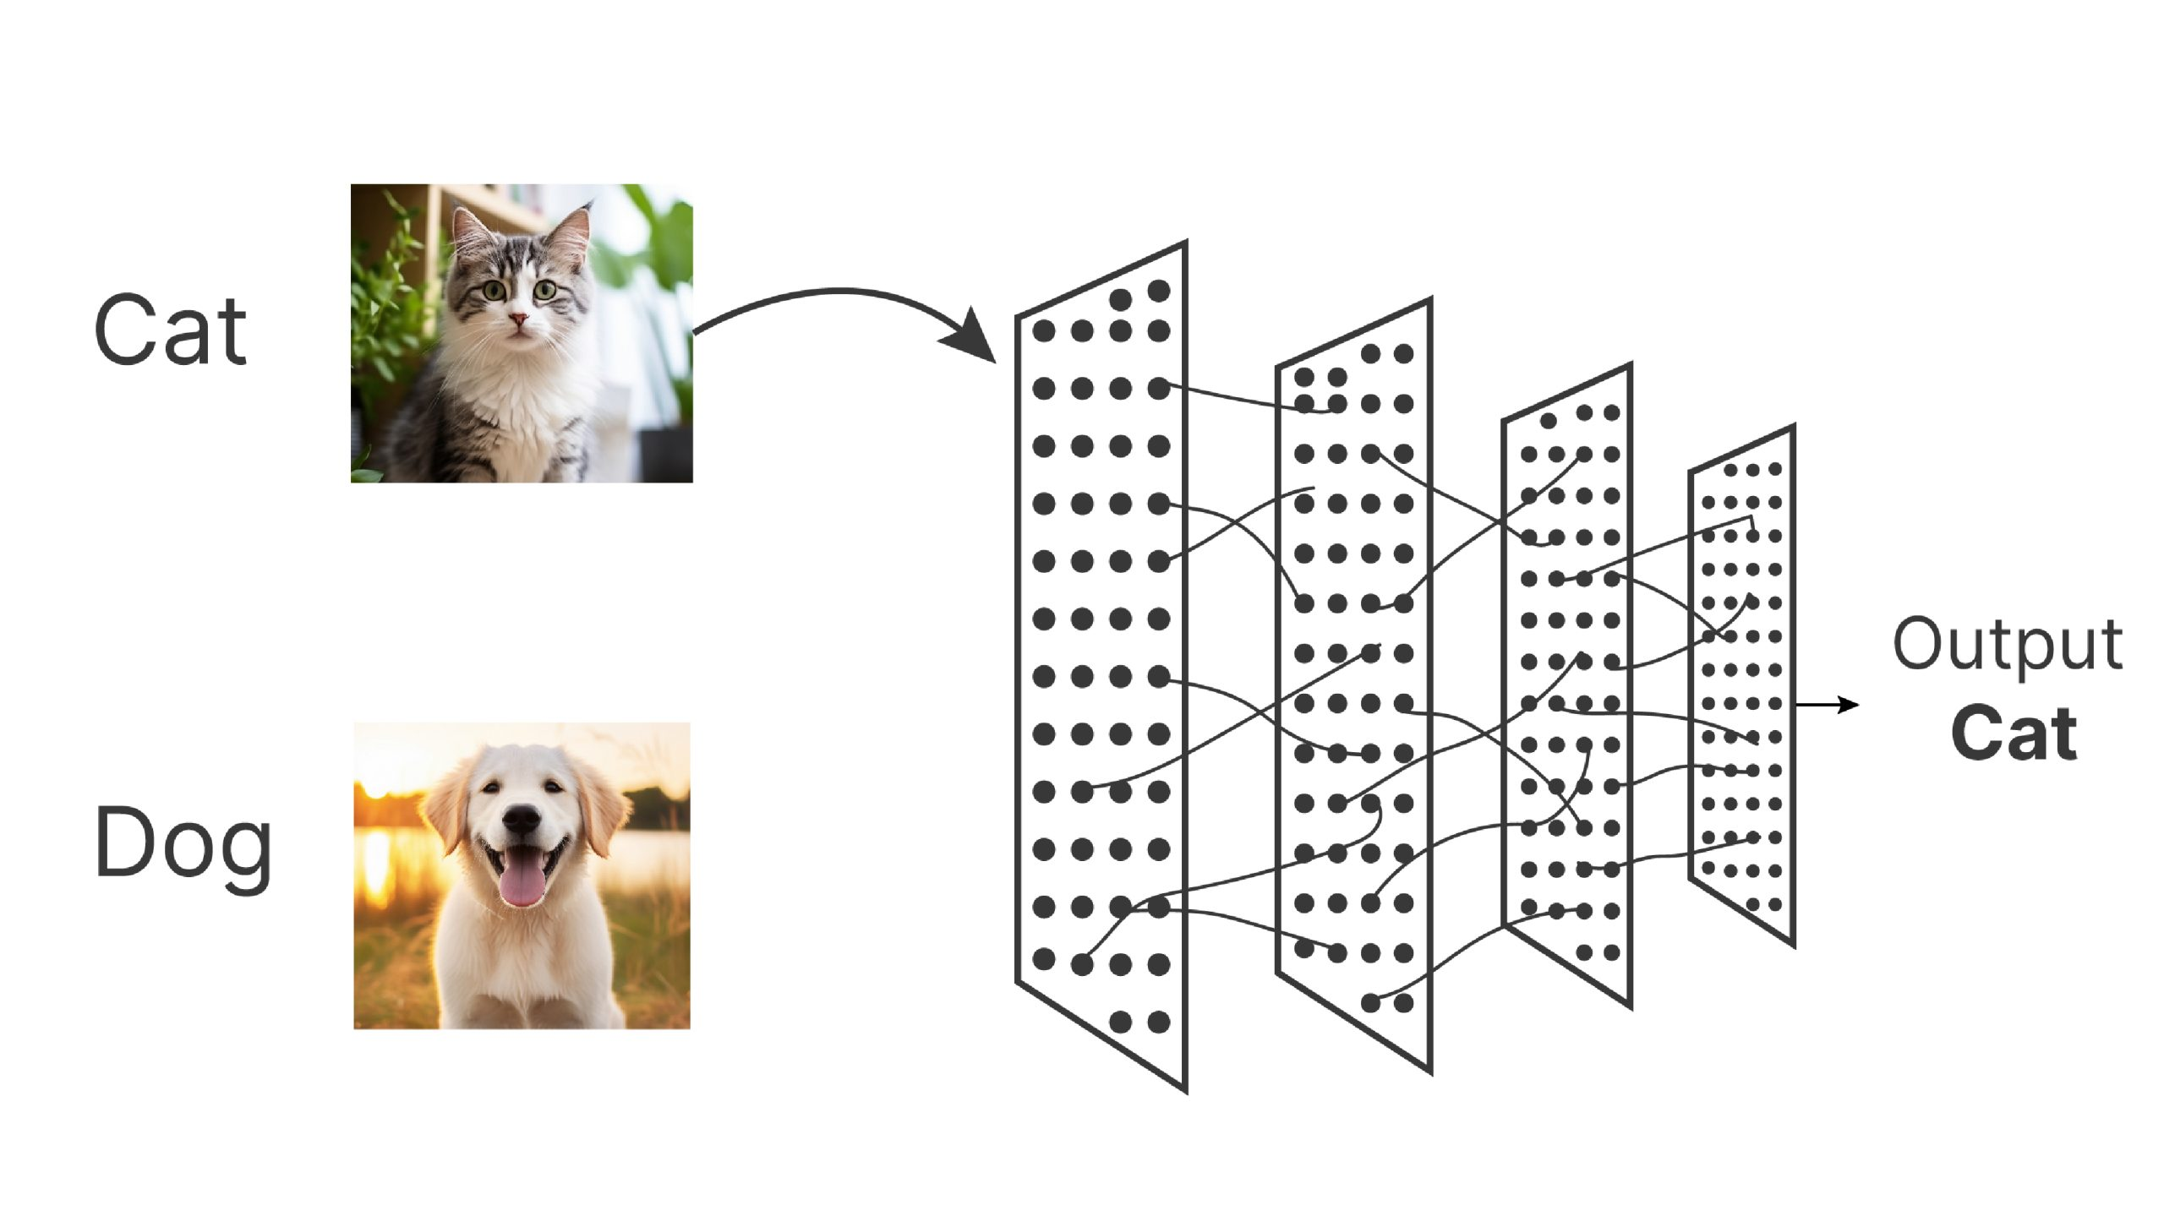
Classifying the image as a cat or a dog
To classify the image as a cat or dog we can use a CNN with the following:
An input layer which takes the raw pixels as input
4 Hidden Layers
1 output layer that uses the sigmoid activation function as this is a binary classification.
output layer
Input layer
hidden layers

Slide 24
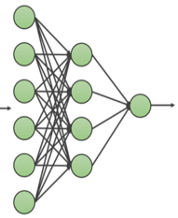
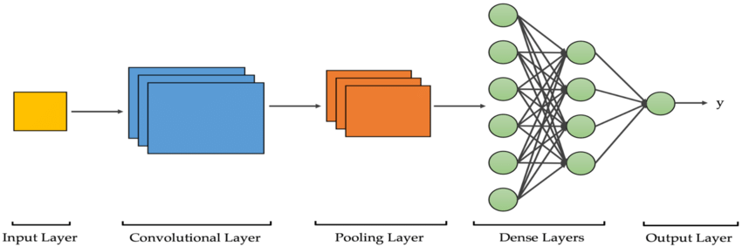
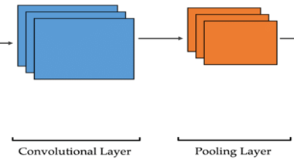
4 Hidden layers:
The first hidden layer uses the ReLU activation function to introduce non-linearity
It uses 32 filters and a stride of (2,2) where the stride defines the number of pixels to move to the right or down
Then pooling is done which downsizes the image by 2
The next hidden layer also follows the same architecture but this has 64 nodes instead of 32
The next hidden layer employs 128 nodes and follows the same architechture as the other two hidden layers.
The image is then flattened before it can be passed to the dense layers.
This is followed by a Dense Layer which consists of 512 nodes and uses the Relu activation function to learn high-level combinations of features.
Input

Slide 25
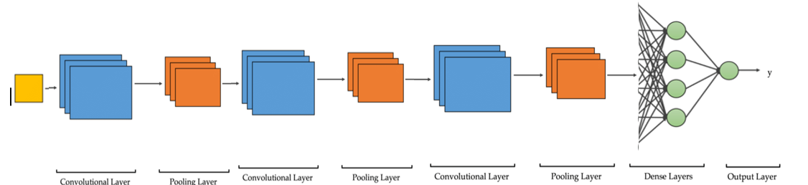
The output layer
The output layer receives input from the dense layer .
It contains only 1 node and employs a sigmoid activation function to classify the images into two classes.
This would be the complete architecture of out CNN model:

Slide 26
Optimizing the Neural Network
The Neural network can be optimized by using early stopping technique and reducing the learning rate in order to reduce overfitting on the training data.
Optimizing by using Early-Stopping:
It is used to stop training before the model starts overfitting. It monitors validation loss or validation accuracy.
If there's no improvement for a set number of epochs (called patience), training stops.
Optimizing the learning rate:
When the model stagnates, a smaller learning rate can help fine-tune weights more precisely.

Slide 27
Optimizing the Neural Networks Architecture
Optimizing the number of hidden layers and the number of nodes in each layer:
To optimize the number of hidden layers and nodes per layer, it is advisable to start with a reasonably complex architecture. If the model shows signs of overfitting (e.g., high training accuracy but low validation accuracy), reduce the complexity by decreasing the number of layers or neurons. Conversely, if the model shows underfitting (e.g., low accuracy on both training and validation), increase the complexity.
Start complex but not arbitrarily huge (deep nets are expensive and prone to overfit).
Use validation metrics to guide changes.
Optionally apply regularization (e.g., dropout, L2) before simplifying the model too much.

Slide 28
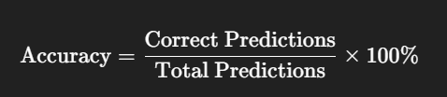
Accuracy
Accuracy is the percentage of correctly predicted results out of the total number of predictions.
Achieved training accuracy of 92-94%
Achieved validation accuracy of 86-88%
This means the model correctly predicted cat/dog images 86-88% of the time on unseen data
High accuracy indicates the model has learned well from the training data and generalizes decently on new data.

Slide 29
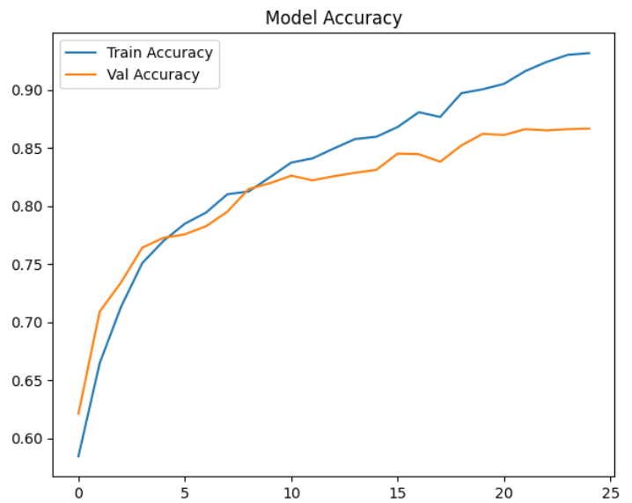
Train Accuracy Vs Test Accuracy
Here , the model starts to overfit i.e it starts to memorize the data rather than learn from it to generalize better.
In the graph the train accuracy continues to increase whereas the validation loss increases and then plateaus from around 10-12 epochs
Accuracy
Epochs

Slide 30
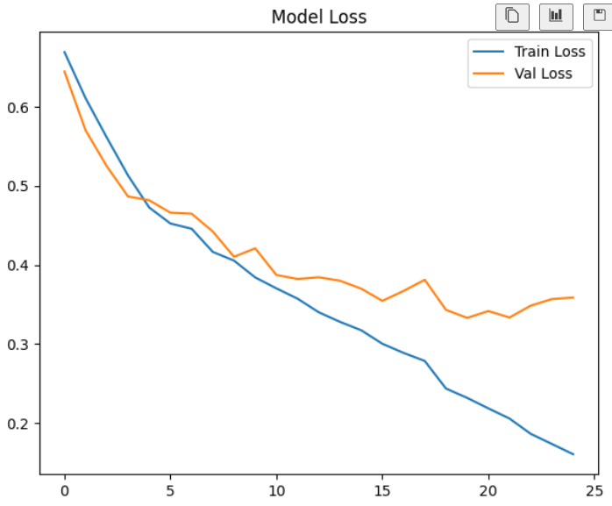
Train loss vs test loss
Here , the model starts to overfit i.e it starts to memorize the data rather than learn from it to generalize better.
In the graph the train loss continues to decrease whereas the validation loss decreases and then plateaus from around 10-12 epochs
Loss
Epochs

